Slide 1


Green Pace
Security Policy Presentation
Developer: Jorden Thomas

Slide 2

OVERVIEW: DEFENSE IN DEPTH
The purpose of this policy is to define the core security principles; C/C++ coding standards; authorization, authentication, and auditing standards; and data encryption standards.

Slide 3
THREATS MATRIX
a tool used to identify and prioritize the highest risks to an organization or system
Likely refers to the probability of a threat occurring | Priority indicates the urgency and importance of addressing the threat.
Low priority indicates that the potential impact or consequences are not severe. | Unlikely a threat could occur in some circumstances, but it's unlikely to happen

Slide 4
10 PRINCIPLES
Validate Input Data
Heed Compiler Warnings
Architect and Design for Security Policies
Keep It Simple
Default Deny
Adhere to the Principle of Least Privilege
Sanitize Data Sent to Other Systems
Practice Defense in Depth
Use Effective Quality Assurance Techniques
Adopt a Secure Coding Standard

Slide 5
CODING STANDARDS
Data type
Data Value
String Correctness
SQL Injection
Memory Protection
Assertions
Exceptions
Object Oriented Programming
Containers
Expressions

Slide 6
ENCRYPTION POLICIES
Encryption in rest:
protects stored data. Include hard drives, phones, computers, and cloud assets, among others. Protection is done through encryption tools, disk encryption, and security for mobile devices and computers.
Encryption at flight:
Protects data that is moving. This can be between two devices within a network or moving outside of a network. It’s also important to consider the path that the data may be taking, and the security of this path.
Encryption in use:
Protects data that is created, edited, or otherwise defined as in-use. Protection of this data can be done by ensuring data control and protection exists before use. Managing access rights and identity will also minimize risk to this data.

Slide 7
TRIPLE-A POLICIES
Authentication:
The act of confirming one’s identity. This can cover a range of types, but often are examples such as static passwords, one-time passwords, certifications, and biometric credentials.
Authorization:
After confirming one’s identity, authorization will then determine what a user can and cannot access, limiting possible vulnerabilities when someone interacts with sensitive data. They may not need access to said data or the permissions one may have during access.
Accounting:
The process of keeping track of activity while interacting with a system, showing timestamps, accessing resources, and data transfer information. This is valuable in both creating a “breadcrumb trail” in user activity and for forensic analysis and investigation, should it be required.

Slide 8
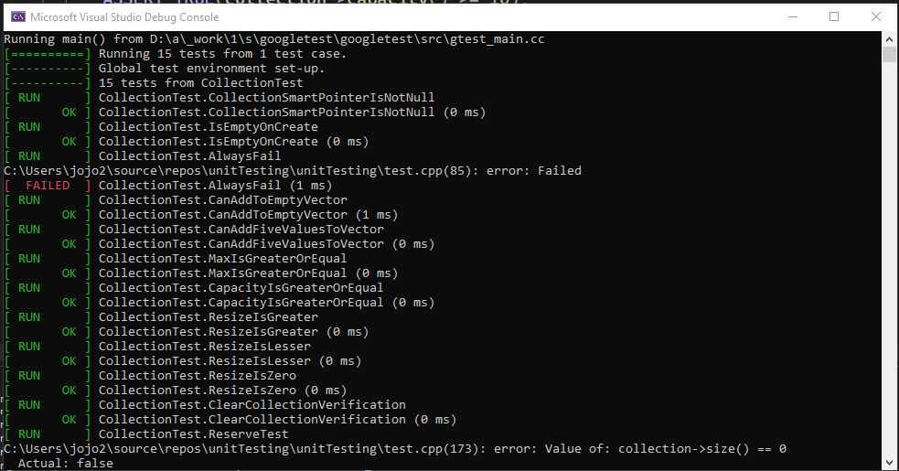
Unit Testing
During module 4 we worked on unit testing, as we can see below the initial testing ran correctly.

Slide 9
Unit Testing
During this test we can see that the collectionTest.AlwaysFail did in fact fail the reason for the failure is listed as the Value of: collection->size() == 0

Slide 10
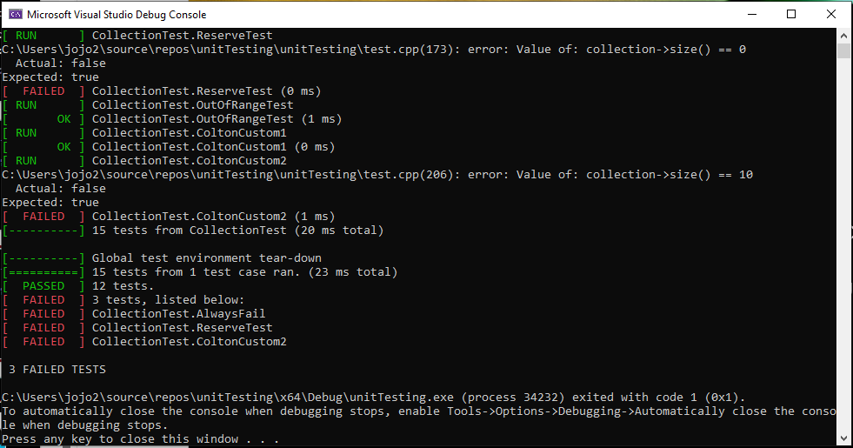
Unit Testing
During this run the failure came from the CollectionTest.ReserveTest

Slide 11
Unit Testing
Lastly we have the final test and it failed for the CollectionTest.ColtonCustom2
In total we had three failures that happened from the CollectionTest.AlwaysFail, CollectionTest.ReserveTest, and CollectionTest.ColtonCustom2

Slide 12

AUTOMATION SUMMARY

Slide 13
TOOLS
DevSecOps Pipeline: an automated workflow that integrates security practices throughout the software development lifecycle
External Tools:
SAST (Static Application Security Testing) Tools
DAST (Dynamic Application Security Testing) Tools
SIEM (Security Information and Event Management) Tools
Parasoft C/C++ Testing

Slide 14
RISKS AND BENEFITS
Act Now
Benefits:
Stops future security breaches
Helps to ensure future projects are done securely
Risks:
Momentarily halts the production
Requires time to implement effectively
Choose To Wait
Benefits:
Does not stop production
Minimizes the time spent on training
Risks:
Raises the risk of a breach
Costly if risk is found too late

Slide 15
RECOMMENDATIONS
Security policy gaps that need to be addressed are inadequate employee training, insufficient vulnerability management, and a lack of robust incident response plans.
Other gaps to consider include:
Lack of comprehensive security audits
Regular security assessments help identify potential vulnerabilities and weaknesses, allowing for proactive mitigation.
Insufficient security controls
Organizations may lack adequate controls for authentication, authorization, and data protection.
Poorly defined security policies
Vague or outdated security policies can lead to confusion and inconsistent practices.

Slide 16
CONCLUSIONS
To Identify potential gaps in the security policy you will need to conduct a thorough assessment of your current policies, procedures, and practices.
Conduct a security policy review
Inventory Current Policies
Identify Relevant Standards
Gap Analysis
Evaluate Policy Effectiveness
Assess Implementation
Review Audit Logs
Consider Employee Training
Identify Specific Gaps
Missing Policies
Out-of-Date Policies
Conflicting Policies
Poorly Implemented Policies
Prioritize and Address Gaps
Risk Assessment
Develop Remediation Plan
Implement Changes
Monitor and Evaluate

Slide 17
REFERENCES
10 of the most common security gaps, and how you can fix them - celerity limited. Celerity UK. (n.d.). https://celerity-uk.com/blog/10-of-the-most-common-security-gaps-and-how-you-can-fix-them/#:~:text=1.,accidentally%20become%20your%20weakest%20link.
Cyber security gaps: How to know what needs attention. SSI. (n.d.). https://insider.ssi-net.com/insights/cyber-security-gaps-learn-how-to-know-what-needs-attention#:~:text=There%20are%20specific%20gaps%20in,before%20any%20damage%20is%20done.
The United States Government. (2022, March 22). Fact sheet: Act now to protect against potential cyberattacks. The White House. https://www.whitehouse.gov/briefing-room/statements-releases/2022/03/21/fact-sheet-act-now-to-protect-against-potential-cyberattacks/
What is cybersecurity risk? definition & factors to consider in 2024. SecurityScorecard. (2024, November 13). https://securityscorecard.com/blog/what-is-cybersecurity-risk-factors-to-consider/

